Slide 1
Hackathon problem statement
WELDING

Slide 2
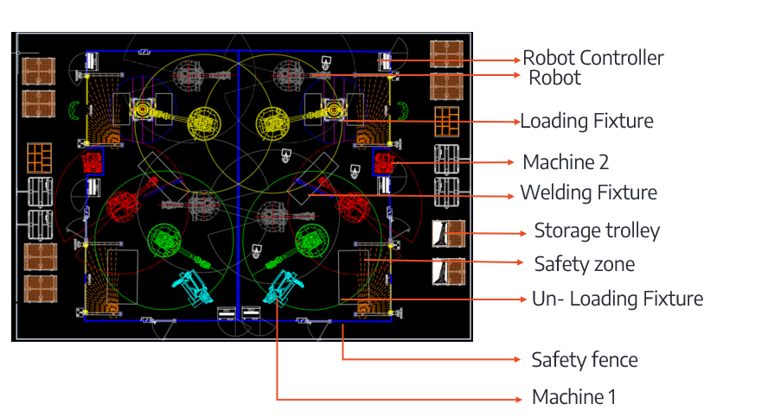
Problem title_1 : WPE_Layout Optimization
Background
Sample data
In manufacturing plants, available floor space is often limited, making it difficult to position machines, workstations, material storage areas, inspection stations, and utility resources efficiently.
Layout planners must ensure smooth material flow, operator accessibility, safety clearances, and production targets while working within space constraints. Currently, evaluating multiple layout alternatives requires significant manual effort, resulting in numerous iterations and extended planning time.
Out put requirement
Rules
A minimum clearance of 800 mm shall be maintained between a robot and any machine/equipment.
A minimum clearance of 700 mm shall be maintained between two robots.
A clear and unobstructed pedestrian walkway shall be provided throughout the layout to ensure safe movement of personnel.
A minimum clearance of 600 mm shall be maintained between any resource/equipment and the safety fence.
All material storage locations shall be positioned to ensure easy and safe accessibility for operators.
A minimum clearance of 100 mm shall be maintained between adjacent material storage trolleys.
Material storage trolleys shall always be located along the layout boundary/perimeter and shall not obstruct production resources or pedestrian paths .
Develop an intelligent layout optimization tool that can analyze available shopfloor space and propose the best arrangement of equipment, workstations, material storage, and supporting resources.

Slide 3
Problem title_1 : WPE_Layout Optimization
What is JPH?
JPH (Jobs Per Hour) is the number of products a production line needs to produce in one hour.
Example: 60 JPH = 60 products/hour.
How is it calculated?
Cycle Time = 3600 ÷ JPH
For 60 JPH → 3600 ÷ 60 = 60 seconds/job.
So, one product needs to be completed approximately every 60 seconds.
How do we find the required resources?
First, identify the work activities and their time. Then compare the work time with the required cycle time.
Required Resources ≈ Work Time ÷ Cycle Time
Example: 120 sec work ÷ 60 sec cycle time = 2 resources.
Current Process
Collect JPH & process data → Calculate resources → Place equipment manually → Check space, flow & movement → Adjust the layout → Repeat.
The Problem
Factory space is limited, and manually finding the best arrangement can be time-consuming, repetitive and dependent on planner experience.

Slide 4
Problem title_1: WPE_Layout Optimization
Two Stations to be build in the allocated area
Station 1:
Station 2:
S.No | Equipment / Resource | Numbers of equipment's
1 | Loading Fixture | 1
2 | Robots | 3
3 | Robots' controller | 3
4 | Machine 1 | 1
5 | Machine 2 | 1
6 | Unload Fixture | 1
7 | Safety zone | 2
8 | Material storage trolley 1 | 8
9 | Material Storage trolley 2 | 1
S.No | Equipment / Resource | Numbers of equipment's
1 | Loading Fixture | 1
2 | Robots | 5
3 | Robots' controller | 5
4 | Machine 1 | 1
5 | Machine 2 | 0
6 | Unload Fixture | 1
7 | Safety zone | 2
8 | Material storage trolley 1 | 8
9 | Material Storage trolley 2 | 2

Slide 5
THANK YOU

